Slide 1

Decoding Dropout Rates
A Multi-Faceted Quantitative Analysis of High School Students' Retention Rate based on social factors & perception of schooling
By Amanda Tran

Slide 2
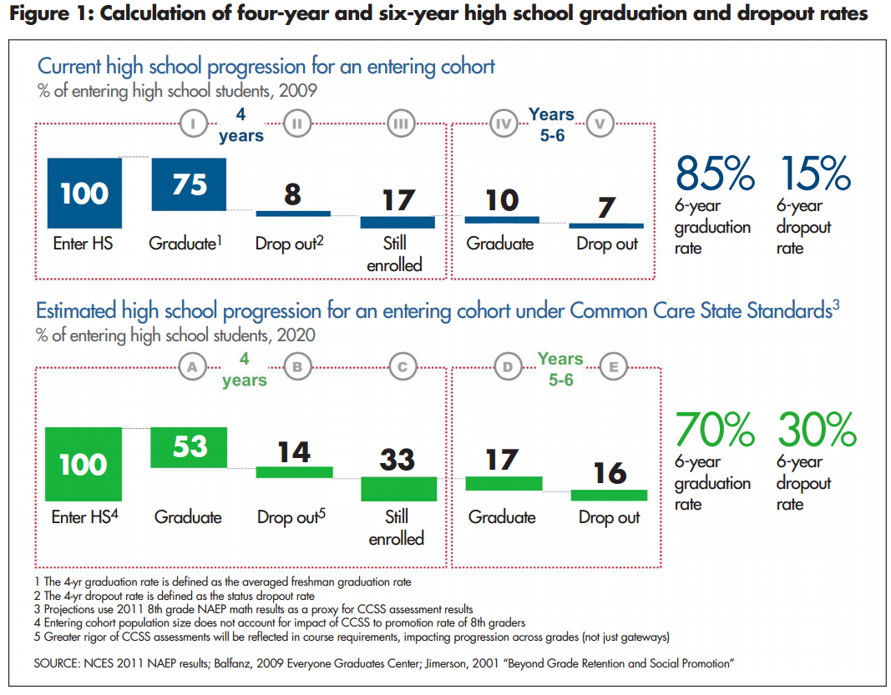
Problem Statement
High school dropout rates in the U.S.
How are schools defining success?
How are students defining success?
Does success = going to college?
This Photo by Unknown author is licensed under CC BY-NC.

Slide 3

Data Source
NCES's 2002-2012 National Longtitudinal Study
Base-year to first Follow-up (F1) student administered surveys

Slide 4
Data cleaning & Composition
Non-response values – NAs
Filtered out homeschooled students
Mutated values:
Hours count (numerical)
Extracurricular participation (Boolean)
13,194 responses of 139 variables:
114 factors
22 numeric
3 logical

Slide 5

Data Composition
School Environment Perception
Safety
Attendance/Tardiness
Academic Involvements
Attitudes Towards School and Learning
Participation in Learning Enhancements
EC participation
Studying habits (by hours)
Importance of Various Life Aspects
Parental's Education Attainment & Involvement in Education

Slide 6
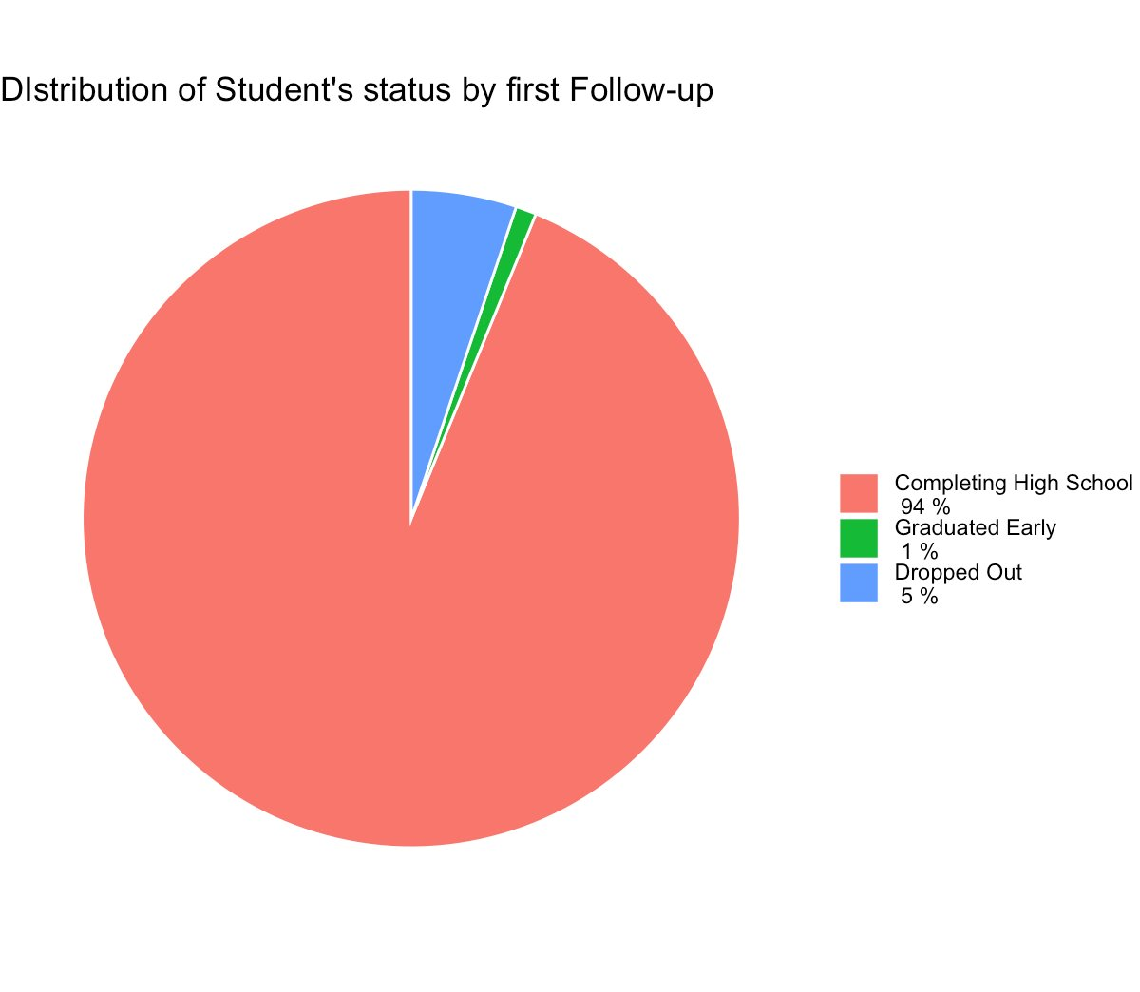

Slide 8
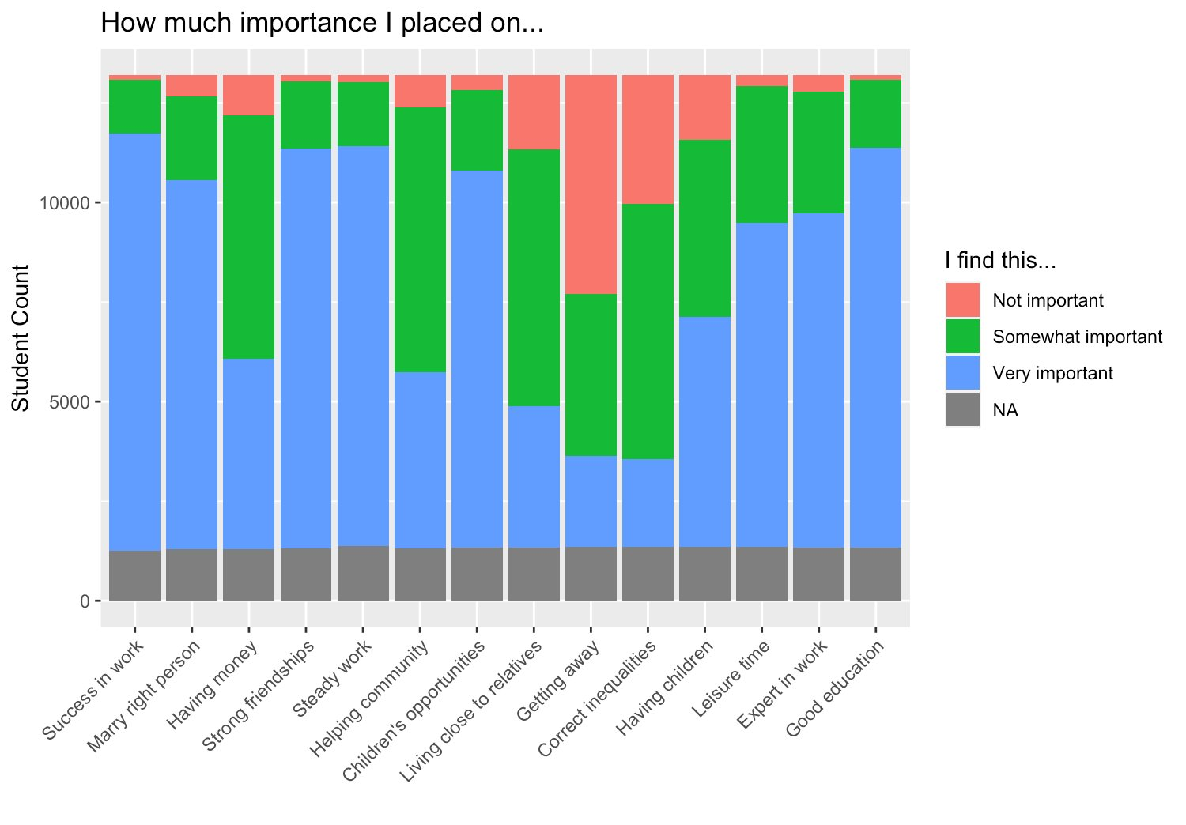

Slide 11
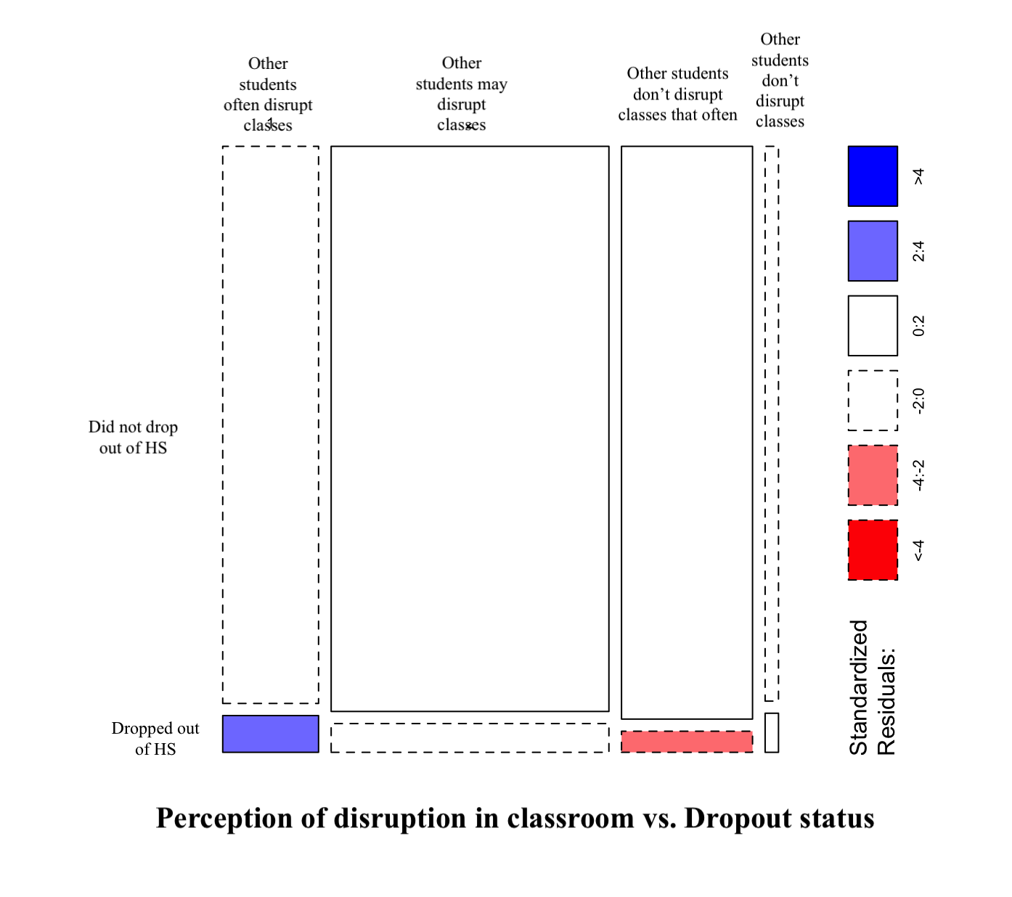
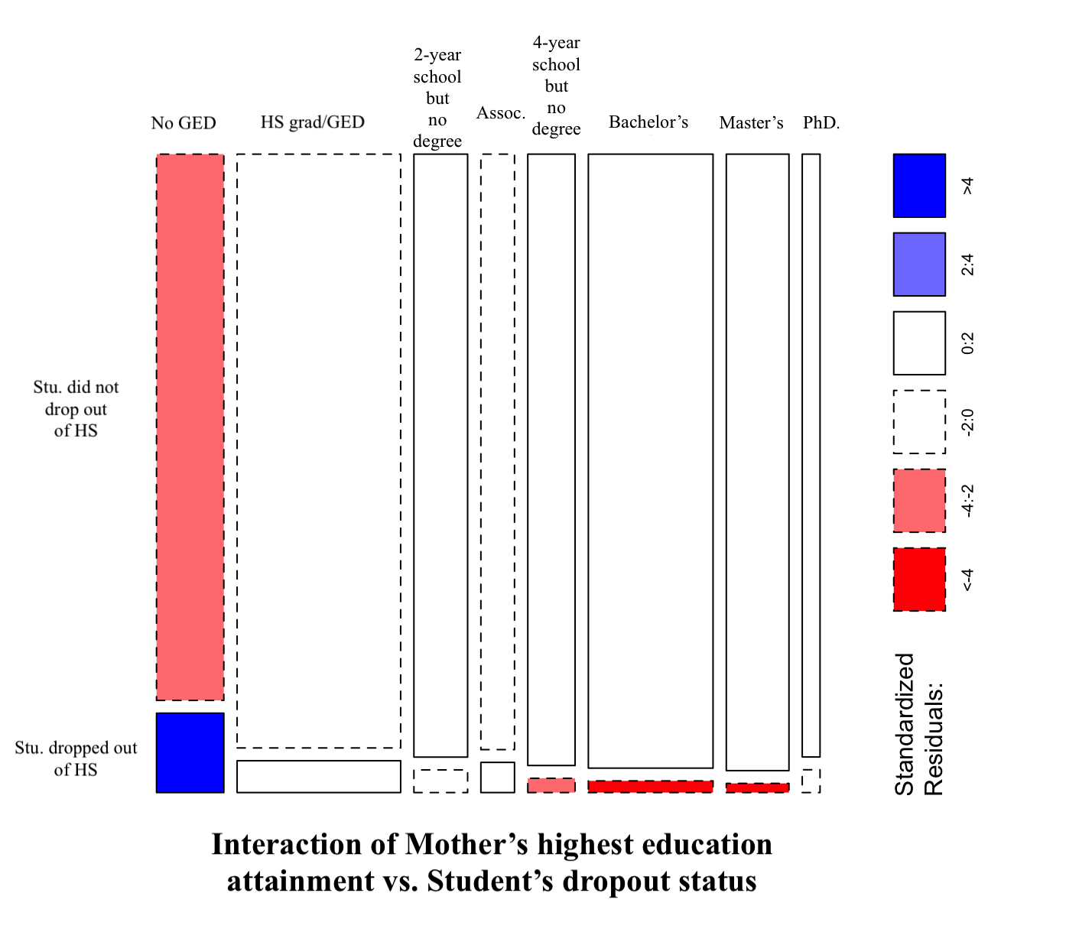
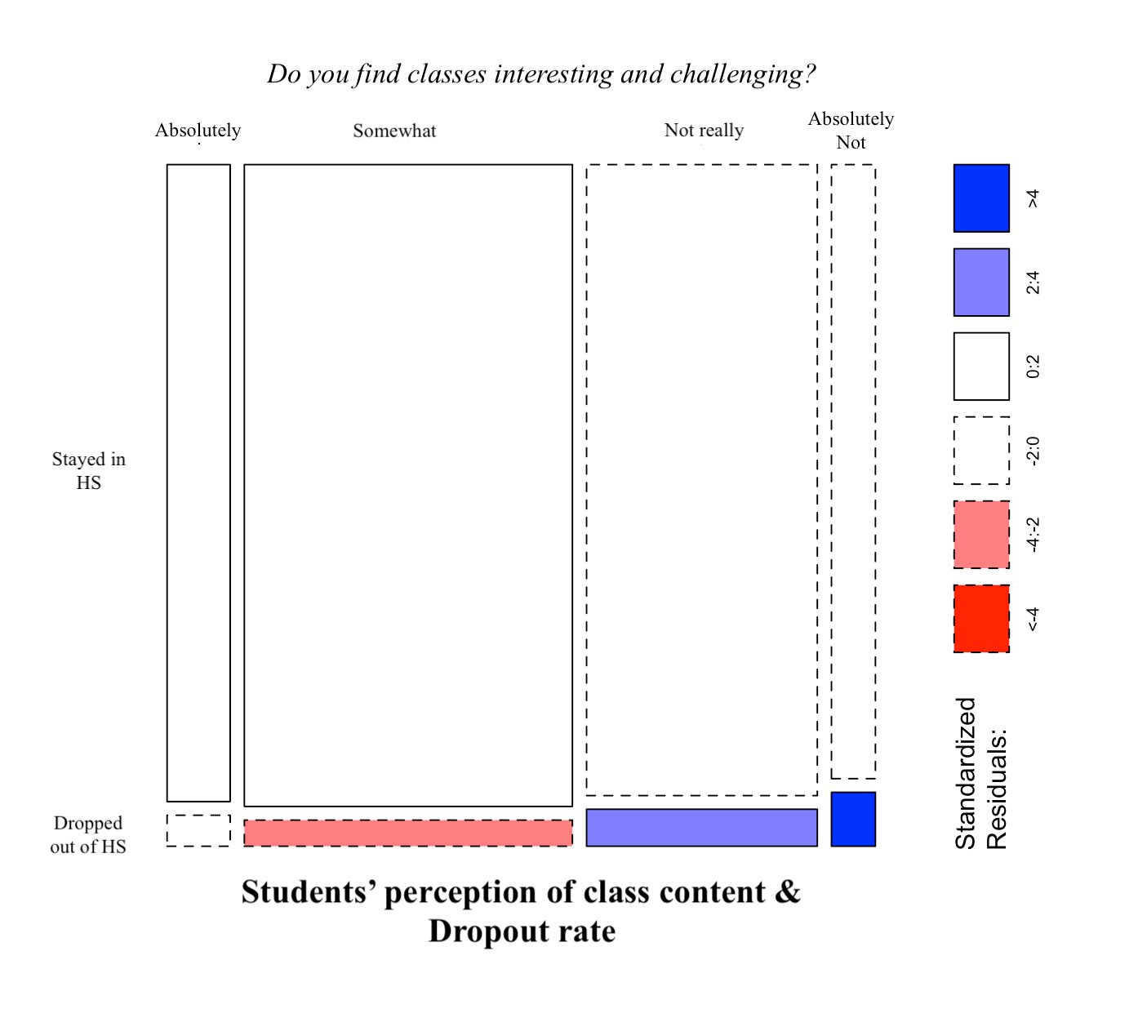
Direct relations with dropout status

Slide 12
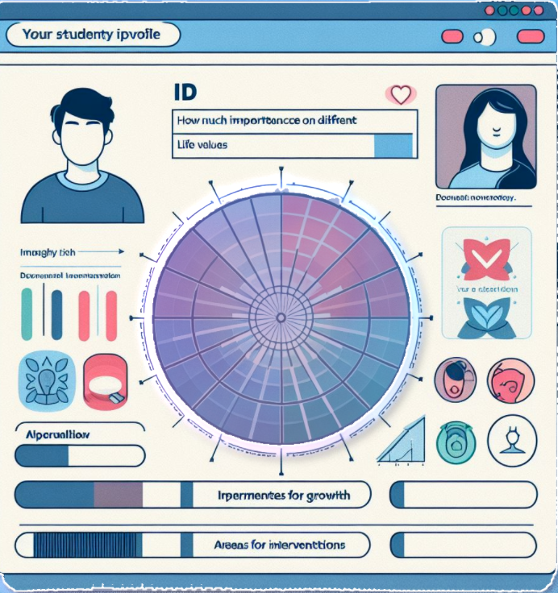
Next steps
Implement data imputation for unfilled/skipped/missing values
Train & test predictive logistic regression models
Involves Bagging/Boosting as needed!
Create a simple interface for the recommendation system
Visualization
Suggested search terms

Slide 13

Implications for Stakeholders
Students:
Identify areas of struggle: academic performance, school environment perception, personal issues.
Empower students to understand weak points and work towards improvement.
Parents:
Gain insights into child’s school life.
Guide parental support and advocacy for child’s needs at school.
School Counselors & Teachers:
Receive data-driven insights tailored to each student.
Develop effective intervention strategies and support plans.
Inform teaching strategies and interactions to better support learning and engagement.
School Administration:
Highlight systemic issues contributing to dropout rates.
Guide policy and program decisions to enhance student retention.

Slide 14
Legal & Ethical Considerations
De-identified data
Demographic variables excluded
Deviating from standardized metrics
Support, rather than impose

